Slide 1
Coding Club 2021 - Python Session 3
Excel Manipulation and Data Processing

Slide 2
1
Last Session Assignment Review (10 min)
2
Background and Theories (20 min)
Agenda
3
Coding Time
(60 min)
4
Assignment

Slide 3
Last Session Assignment Review (10 min)
Recap assignment
Sample solution
Q&A

Slide 4

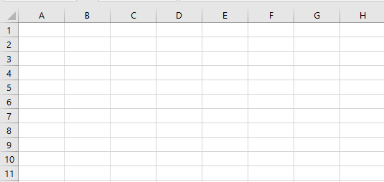
Background and Theories (20 min)
Column
Dataframe
Row
Series
Index
.xlsx / .csv
Notes:
What is Data Processing (4 min)
Series: one-dimensional labelled array (list) capable of holding any data types
DataFrame: a 2-dimensional labelled data structure with columns of potentially different types. Like a spreadsheet.
Why use Python (example of advantage over Excel and other MS softwares)
Flexibility of import / export

Slide 5


Background and Theories (20 min)
Access files | One-by-one | Loop open multiple files
Load files | A few sec depends on file size | In the order of nano sec
.xlsx files | ✓ | ✓
Data manipulation (e.g. calculate, filter, lookup, sort) | Various functions in Excel | Various functions in Python
Linkage between files | Excel functions / Macro / PowerQueries, need to refresh each time | Grab latest version each time when run
Export | Manual selection of file types | Can teach to save as .xlsx / .csv
Pros | Visually easy to understand | Teach once, same process can be repeated again fast (thus used heavily in big data in order of TB)

Slide 6
Reading CSV’s in Pandas
We need to import pandas so we can use pandas DataFrames
import pandas as pd
import os
# change current directory to location of our files
os.chdir(r“path to where you saved the folder")
# read SamplingData csv file
df = pd.read_csv("Sourdough.csv, parse_dates=True, dayfirst=True)
In Python \ is a special character. Use / for file paths (or \\)
Treat the date strings as date_time objects
We’re not American!
If you don’t want to treat it as a list of dates you don’t need to use all the extra arguments….

Slide 7
Reading Excel Files in Pandas
Reading Excel files is done in a similar way to reading csv files, using the read_excel function.
Note that reading very large Excel files takes much longer than reading large csv files. So if you are working with a large amount of data in Excel, think about converting it to a csv!
# read SamplingData excel file
df = pd.read_excel(" Sourdough.xlsx", sheet_name=“Sourdough”, parse_dates=True, dayfirst=True)
Read this sheet name in excel

Slide 8
Reading Files in Pandas
read_csv and read_excel functions in Pandas have lots of additional useful arguments
See: http://pandas.pydata.org/pandas-docs/stable/generated/pandas.read_csv.html for more information
See: http://pandas.pydata.org/pandas-docs/stable/generated/pandas.read_excel.html for more information
A couple of useful ones:
skiprows: Number of lines to skip at the start of the file
na_values: Additional strings to recognize as NA/NaN.
By default the following values are interpreted as NaN: ‘’, ‘#N/A’, ‘#N/A N/A’, ‘#NA’, ‘-1.#IND’, ‘-1.#QNAN’, ‘-NaN’, ‘-nan’, ‘1.#IND’, ‘1.#QNAN’, ‘N/A’, ‘NA’, ‘NULL’, ‘NaN’, ‘nan’`.

Slide 9
Writing Files in Panda
# Write SamplingData to csv named SamplingData_copy.csv
df.to_csv(“Sourdough_copy.csv")
df.to_excel(“Sourdough _copy.xlsx”, sheet_name = “Sourdough”)
To write a single object to an Excel .xlsx file it is only necessary to specify a target file name. To write to multiple sheets it is necessary to create an ExcelWriter object with a target file name, and specify a sheet in the file to write to.

Slide 10
# read SamplingData excel file
SamplingData = pd.read_excel(" SamplingData.xlsx", sheet_name=“Sourdough”, parse_dates=True, dayfirst=True)
Read this sheet name in excel

Slide 11
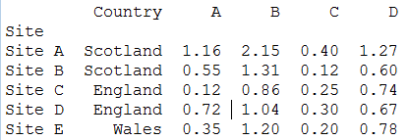
Summary statistics for groups of data using groupby
# find min of each column in DataFrame, grouped by site
print(SamplingData.groupby('Site').min())
# create a new column to hold the year of sampling and find the minimum value from each year
SamplingData['Year’] = SamplingData.index.year
print(SamplingData.groupby('Year').min())

Slide 12
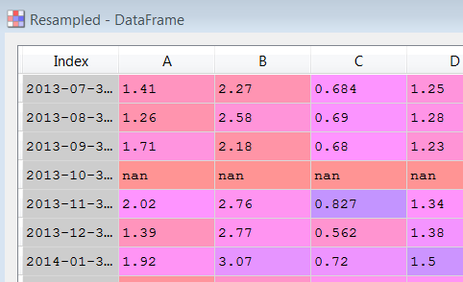
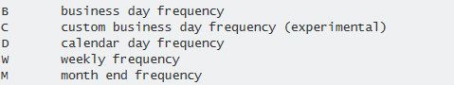
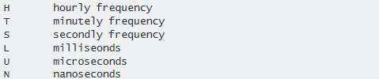
Summarise data by time using resample
You can also use max(), mean(), cumsum(), count(), mediam(), var(), std()…
Resample
# get monthly mean of each column in SamplingData
Resampled = SamplingData.resample('M').mean()
Lots of different in built frequency switches (or you can specify a list of your own dates of use other custom frequency options):
See Offset Aliases in http://pandas.pydata.org/pandas-docs/stable/timeseries.html

Slide 13
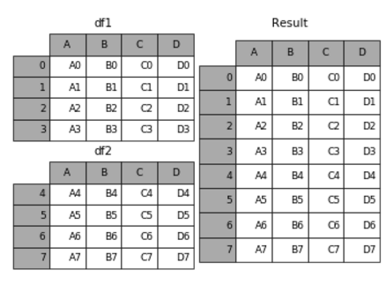
Joining DataFrames using append
# join two DataFrames by row
Result = df1.append(df2)
There are lots (!) of other ways to join and merge DataFrames. See: http://pandas.pydata.org/pandas-docs/stable/merging.html

Slide 14
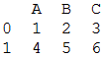
One final thing: Mutable vs immutable DataTypes
You might never need to worry about this but…
# make a new DataFrame to use as our example:
df1 = pd.DataFrame([[1,2,3],[4,5,6]],columns=["A","B","C"])
df1
df1
df2
df2 = df1
# delete column C from df2
df2.pop(“C”)
df1
df2

Slide 15
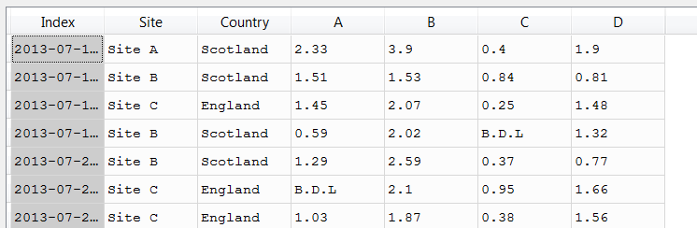
Editing DataFrames: Replacing values
SamplingData = pd.read_csv("SamplingData.csv", index_col=0, parse_dates=True, dayfirst=True)
# replace B.D.L. with detection limit (0.05) for all
# columns in SamplingData
SamplingData[SamplingData == "B.D.L"] = 0.05
SamplingData = SamplingData.dropna()
# convert columns A, B, C and D to numeric datatype
SamplingData[["A","B","C","D"]] = SamplingData[["A","B","C","D"]].apply(pd.to_numeric)
SamplingData
The pandas replace option gives you the option of using regular expressions (pattern matching) which can be required for more complex find/replace operations

Slide 16
Adding and deleting columns
Add a new column to an existing DataFrame:
SamplingData[“SumColumn”] = SamplingData[“A”] + SamplingData[“B”]
Delete a column from a DataFrame:
del SamplingData[“SumColumn”]
Or:
SamplingData.pop(“SumColumn”)

Slide 17
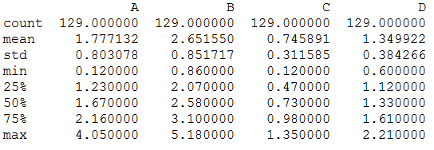
Useful statistics
print(SamplingData[“A”].min())
You can also use max(), mean(), cumsum(), count(), median(), var(), std()…
print(SamplingData.describe())
Some useful summary statistics:

Slide 18

Editing DataFrames: mathematical operations
SamplingData
# multiply column A by 1000
SamplingData[“A”] *= 1000
Column A needs to be a numeric data type

Slide 19
Coding Time (60 min refer to notebook)
Finding new onboard people (understanding data), timesheet combine from different formats and export excel, plot graph (dynamo??)
Teaching points
Generic (in case new people join)
Print, input
Shortcut keys, run by row
Code, markdown, notebook and .py
Import library
Tab function and error handling
Session specific
Read excel / csv
Convert to dataframe
Shape, columns, info
Change data type, count, sort
Mean, SD, filter
Indexing
Replace values, grouping
Data transform, drop
matplotlib
Export to excel / csv, column width

Slide 20
This Session Assignment
From the given directory of timesheets, find out:
What dates does it cover
Who has booked onto task code 7.2.1
What is the total hours booked
Export as a single file and check your answers
There is a bug on the hours, did you manage to find and fix it?
Base assignment with Mott folder only, bonus assignment adding arcadis folder

Slide 21












Background and Theories (20 min)

Slide 22


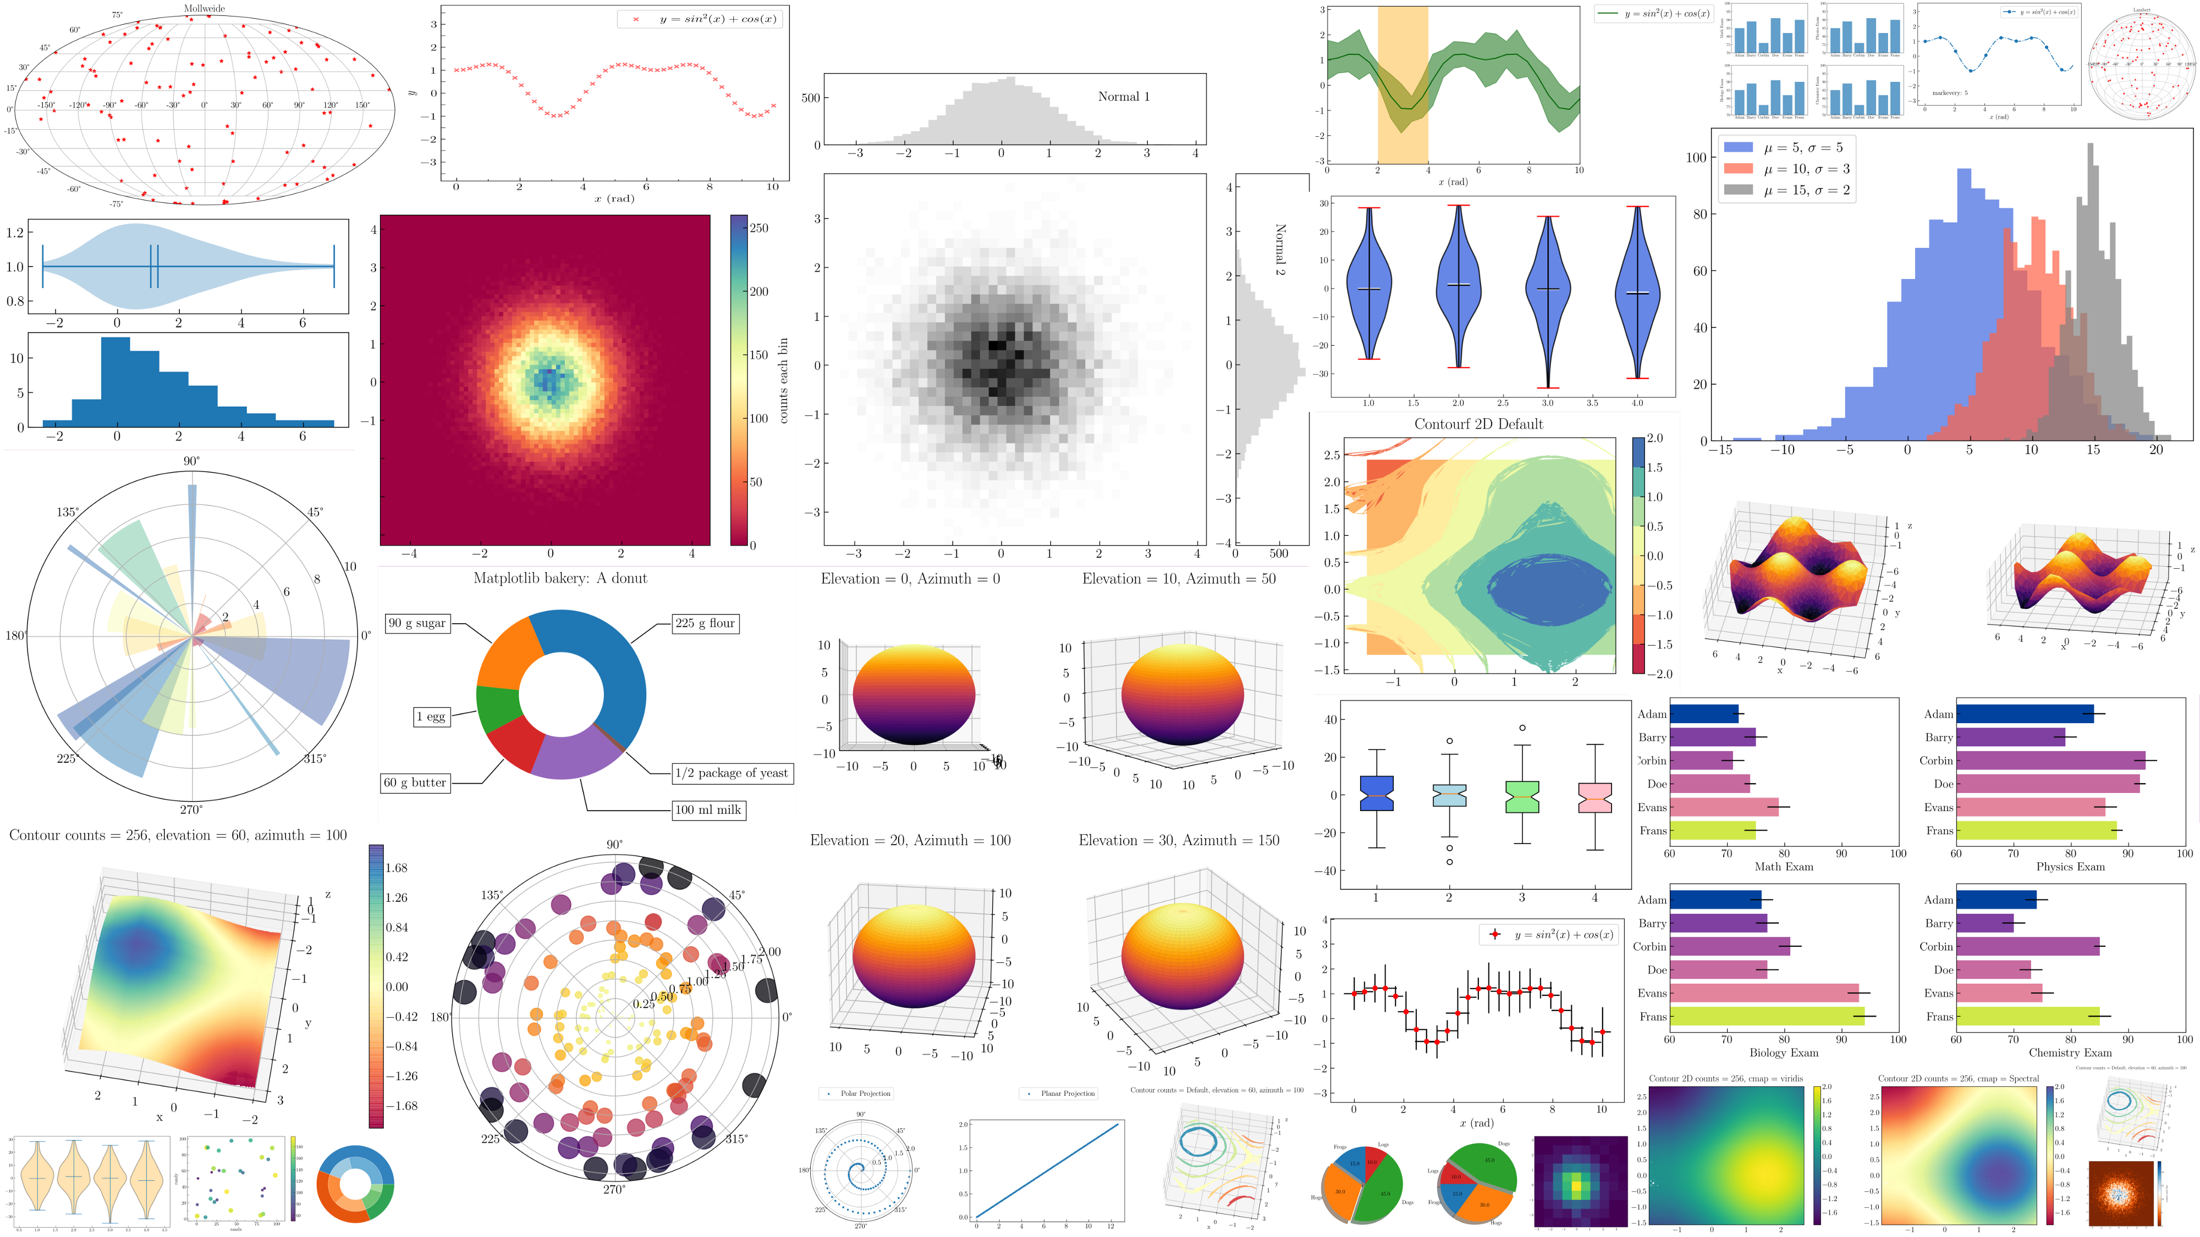
Background and Theories (20 min)
Understanding our data
Import, process and export
Excel manipulation
Notes:
Practical uses of data manipulation (8 min)
Relevancy to Mott MacDonald’s daily practice (eng design, project control)
Technical design software outputs

